Slide 1
Murach’s C# (8th Edition)
Chapter 18
How to use LINQ

Slide 2
Objectives
Applied
Use any of the LINQ features presented in this chapter to query an in-memory data structure such as an array, sorted list, or generic list.
Knowledge
In general terms, explain how LINQ is implemented.
Name the interface that a data source must implement to use LINQ with that data source.
Describe the three stages of a query operation.
Describe how the type of a query variable is determined.
Describe how deferred execution works.
Describe when a query operation results in a projection.
Describe when a query operation results in an anonymous type.

Slide 3
Objectives (continued)
Describe the purpose of each of the following LINQ clauses: from, where, orderby, select, join.
Explain how extension methods and lambda expressions are used with LINQ.
Compare method-based queries to query expressions.

Slide 4
Some of the C# clauses for working with LINQ
from
where
orderby
select
join

Slide 5
Advantages of using LINQ
Makes it easier for you to query a data source by integrating the query language with C#.
Makes it easier to develop applications by providing IntelliSense, compile-time syntax checking, and debugging support.
Makes it easier for you to query different types of data sources because you use the same basic syntax for each type.
Makes it easier for you to use objects to work with relational data sources by using an object relational mapping framework.

Slide 6
The three stages of a query operation
Get the data source.
Define the query.
Execute the query to return the results.

Slide 7
A LINQ query that retrieves data from an array
Code that defines the array
int[] numbers = new int[] { 0, 1, 2, 3, 4 };
A statement that defines the query expression
var numberList = from number in numbers
where number % 2 == 0
orderby number descending
select number;
Code that executes the query
string numberDisplay = "";
foreach (var number in numberList)
numberDisplay += number + "\t\t\n";
MessageBox.Show(numberDisplay, "Sorted Even Numbers");

Slide 8
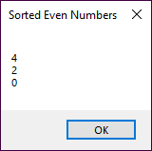
The dialog with the sorted, filtered numbers array

Slide 9
An example that uses an array of decimals as the data source
A statement that gets the data source
decimal[] salesTotals =
new decimal[] { 1286.45m, 2433.49m, 2893.85m,
2094.53m };
A statement that defines the query expression
var salesList = from sales in salesTotals
select sales;
Code that executes the query
decimal sum = 0;
foreach (var sales in salesList)
sum += sales;

Slide 10
An example that uses a generic list of invoices as the data source (part 1)
The Invoice class
public class Invoice
{
public int InvoiceID { get; set; }
public int CustomerID { get; set; }
public DateTime InvoiceDate { get; set; }
public decimal ProductTotal { get; set; }
public decimal SalesTax { get; set; }
public decimal Shipping { get; set; }
public decimal InvoiceTotal { get; set; }
}
A statement that gets the data source
List<Invoice> invoiceList = InvoiceDB.GetInvoices();

Slide 11
An example that uses a generic list of invoices as the data source (part 2)
A statement that defines the query expression
var invoices = from invoice in invoiceList
select invoice;
Code that executes the query
decimal sum = 0;
foreach (var invoice in invoices)
sum += invoice.InvoiceTotal;

Slide 12
An example that filters the salesTotals array
A query expression that returns only sales > $2000
var salesList = from sales in salesTotals
where sales > 2000
select sales;
Code that executes the query
string salesDisplay = "";
foreach (var sales in salesList)
salesDisplay += sales.ToString("c") + "\t\t\n";
MessageBox.Show(salesDisplay, "Sales Over $2000");

Slide 13
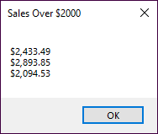
The dialog with the filtered salesTotal array

Slide 14
An example that filters the generic list of invoices
A query expression that returns invoices with totals over $150
var invoices = from invoice in invoiceList
where invoice.InvoiceTotal > 150
select invoice;
Code that executes the query
string invoiceDisplay = "";
foreach (var invoice in invoices)
invoiceDisplay +=
invoice.InvoiceTotal.ToString("c") + "\t\t\n";
MessageBox.Show(invoiceDisplay, "Invoices Over $150");

Slide 15
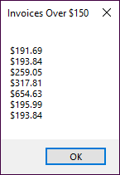
The dialog with the filtered list of invoices

Slide 16
An example that sorts the salesTotals array
A query expression that sorts the sales in ascending sequence
var salesList = from sales in salesTotals
where sales > 2000
orderby sales
select sales;
Code that executes the query
string salesDisplay = "";
foreach (var sales in salesList)
salesDisplay += sales.ToString("c") + "\t\t\t\n";
MessageBox.Show( salesDisplay, "Sorted Sales Over $2000");

Slide 17
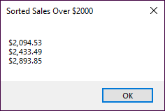
The dialog with the sorted salesTotals array

Slide 18
An example that sorts the generic list of invoices
A query expression that sorts the invoices by customer ID and invoice total
var invoices = from invoice in invoiceList
where invoice.InvoiceTotal > 150
orderby invoice.CustomerID,
invoice.InvoiceTotal descending
select invoice;
Code that executes the query
string invoiceDisplay = "Cust ID\tInvoice amount\n";
foreach (var invoice in invoices)
invoiceDisplay += invoice.CustomerID + "\t"
+ invoice.InvoiceTotal.ToString("c")
+ "\n";
MessageBox.Show(invoiceDisplay, "Sorted Invoices Over $150");

Slide 19
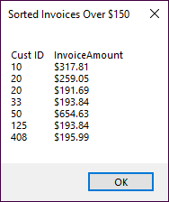
The dialog with the sorted list of invoices

Slide 20
An example that selects key values from a sorted list
The employee sales sorted list
SortedList<string, decimal> employeeSales = new()
{ ["Anderson"] = 1286.45m, ["Menendez"] = 2433.49m,
["Thompson"] = 2893.85m, ["Wilkinson"] = 2094.53m };
A query expression that selects the employee names
var employeeList = from sales in employeeSales
where sales.Value > 2000
orderby sales.Value descending
select sales.Key;
Code that executes the query
string employeeDisplay = "";
foreach (var employee in employeeList)
employeeDisplay += employee + "\t\t\t\n";
MessageBox.Show(employeeDisplay, "Sorted Employees With Sales Over $2000");

Slide 21
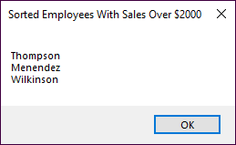
The dialog with key values from the sorted list

Slide 22
A query expression that creates an anonymous type from the list of invoices
var invoices = from invoice in invoiceList
where invoice.InvoiceTotal > 150
orderby invoice.CustomerID,
invoice.InvoiceTotal descending
select new { invoice.CustomerID,
invoice.InvoiceTotal };

Slide 23
An example that joins data from two generic lists
The Customer class
public class Customer
{
public int CustomerID { get; set; }
public string Name { get; set; } = "";
}
Code that gets the two data sources
List<Invoice> invoiceList = InvoiceDB.GetInvoices();
List<Customer> customerList = CustomerDB.GetCustomers();

Slide 24
A query expression that joins data from the two data sources
var invoices =
from invoice in invoiceList
join customer in customerList
on invoice.CustomerID equals
customer.CustomerID
where invoice.InvoiceTotal > 150
orderby customer.Name,
invoice.InvoiceTotal descending
select new { customer.Name, invoice.InvoiceTotal };

Slide 25
Code that executes the query with joins
string invoiceDisplay =
"Customer Name\t\tInvoice amount\n";
foreach (var invoice in invoices)
{
invoiceDisplay += invoice.Name + "\t\t";
invoiceDisplay +=
invoice.InvoiceTotal.ToString("c") + "\n";
}
MessageBox.Show(invoiceDisplay, "Joined Customer and Invoice Data");

Slide 26
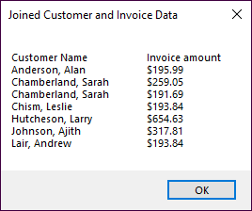
The resulting dialog from the query with joins

Slide 27
A method-based query that filters and sorts the results and selects fields
var invoices = invoiceList
.Where(i => i.InvoiceTotal > 150)
.OrderBy(i => i.CustomerID)
.ThenByDescending(i => i.InvoiceTotal)
.Select(i => new { i.CustomerID,
i.InvoiceTotal });

Slide 28
A method-based query that joins data from two data sources
var invoices = invoiceList.Join(customerList, i => i.CustomerID, c => c.CustomerID, (i, c) => new { c.Name, i.InvoiceTotal }) .Where(ci => ci.InvoiceTotal > 150) .OrderBy(ci => ci.Name) .ThenByDescending(ci => ci.InvoiceTotal);

Slide 29
A method-based query that joins data and selects fields
var invoices = invoiceList.Join(customerList, i => i.CustomerID, c => c.CustomerID, (i, c) => new { c.Name, i.InvoiceDate,
i.InvoiceTotal }) .Where(ci => ci.InvoiceTotal > 150) .OrderBy(ci => ci.Name) .ThenBy(ci => ci.InvoiceDate)
.Select(ci => new { ci.Name, ci.InvoiceTotal });

Slide 30
Additional LINQ methods
Count()
Average()
Sum()
Max()
Min()
First()
FirstOrDefault()
Single()
SingleOrDefault()
Skip()
Take()
ToList()

Slide 31
A query that gets a count of the items in the results
int invoiceCount = invoiceList
.Where(i => i.InvoiceTotal > 150)
.Count();

Slide 32
A query that gets the invoice total for the items in the results
decimal invoiceTotal = invoiceList
.Where(i => i.InvoiceDate >=
DateTime.Parse("01/01/2023")
& i.InvoiceDate <=
DateTime.Parse("06/30/2023"))
.Sum(i => i.InvoiceTotal);

Slide 33
A query that gets a subset of the results
int skipCount = 20;
int takeCount = 10;
var invoices = invoiceList
.Skip(skipCount)
.Take(takeCount);

Slide 34
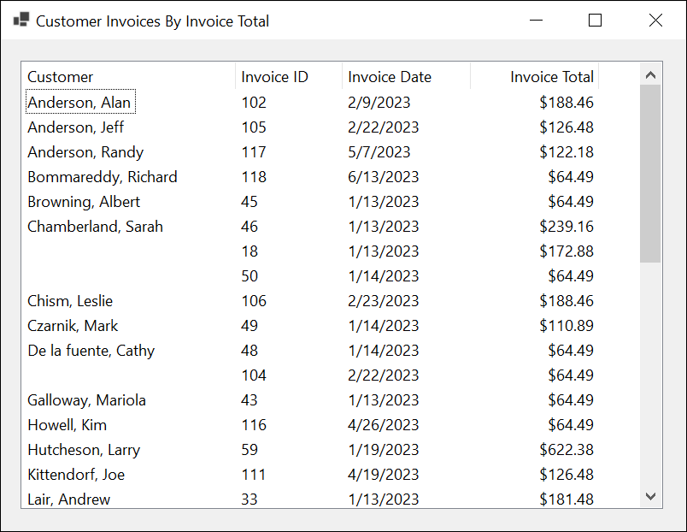
The Customer Invoice form

Slide 35
Code to adjust the column widths based on your screen resolution
protected override void ScaleControl(SizeF factor,
BoundsSpecified specified)
{
base.ScaleControl(factor, specified);
ScaleListViewColumns(lvInvoices, factor);
}
private void ScaleListViewColumns(
ListView listview, SizeF factor)
{
foreach (ColumnHeader column in listview.Columns)
{
column.Width = (int)Math.Round(column.Width
* factor.Width);
}
}

Slide 36
The code for the Customer Invoice form (part 1)
private void frmCustomerInvoices_Load(
object sender, EventArgs e)
{
List<Customer> customerList =
CustomerDB.GetCustomers();
List<Invoice> invoiceList = InvoiceDB.GetInvoices();
var invoices = from invoice in invoiceList
join customer in customerList
on invoice.CustomerID
equals customer.CustomerID
orderby customer.Name,
invoice.InvoiceTotal descending
select new { customer.Name,
invoice.InvoiceID,
invoice.InvoiceDate,
invoice.InvoiceTotal };
string customerName = "";
int i = 0;

Slide 37
The code for the Customer Invoice form (part 2)
foreach (var invoice in invoices)
{ if (invoice.Name != customerName)
{
lvInvoices.Items.Add(invoice.Name);
customerName = invoice.Name;
}
else
{
lvInvoices.Items.Add("");
}
lvInvoices.Items[i].SubItems.Add(
invoice.InvoiceID.ToString());
lvInvoices.Items[i].SubItems.Add(
Convert.ToDateTime(
invoice.InvoiceDate).ToShortDateString());
lvInvoices.Items[i].SubItems.Add(
invoice.InvoiceTotal.ToString("c"));
i += 1;
}
}

